Slide 1


TPC Support Logs
Your daily task companion.
1.0.0.0 LIVE
Login
Name
Search
Password
Login
FAQ
User’s Manual

Slide 2


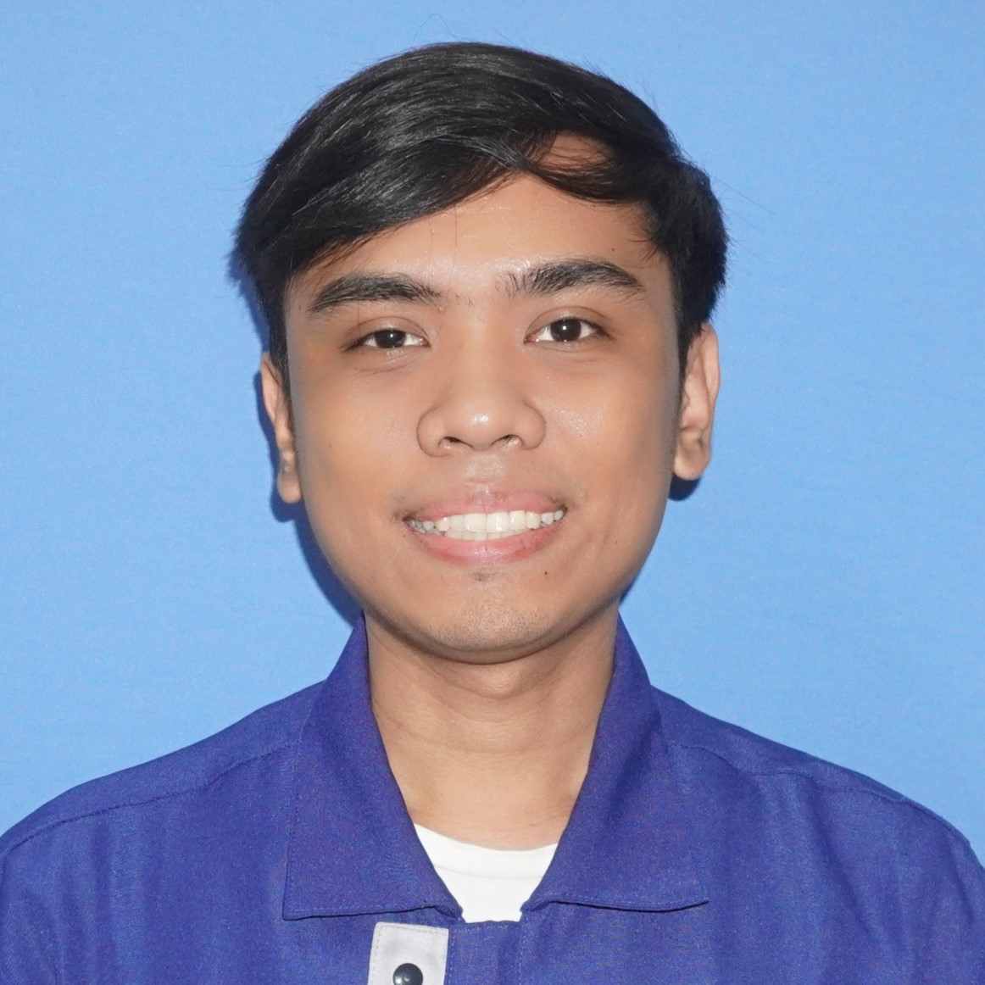



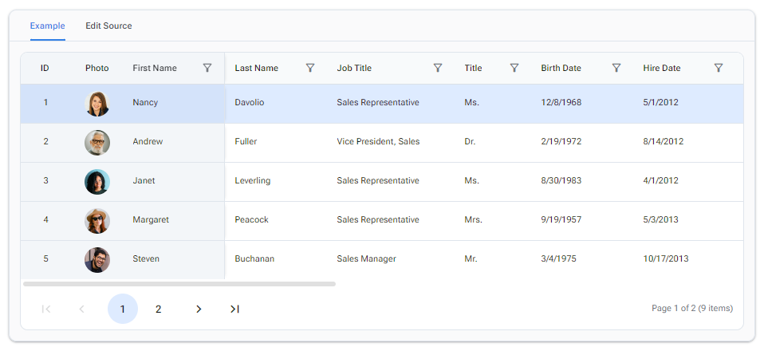




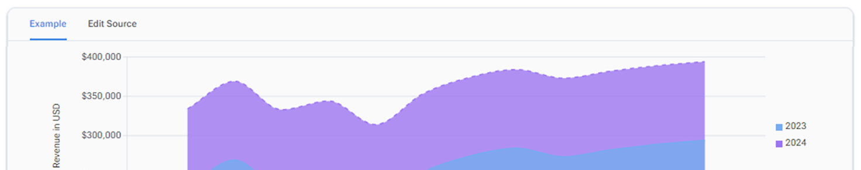
List
Maintenance
TPC Support Logs
1.0.0.0 LIVE
Marq Gonzales
Drawer
Infrastructure
142 rows
INFRA
30 logs
Infrastructure
ERPS
26 logs
SAP ERPS
NON PROD
5 logs
Admin and HR
MFG
3 logs
Manufacturing

Slide 3
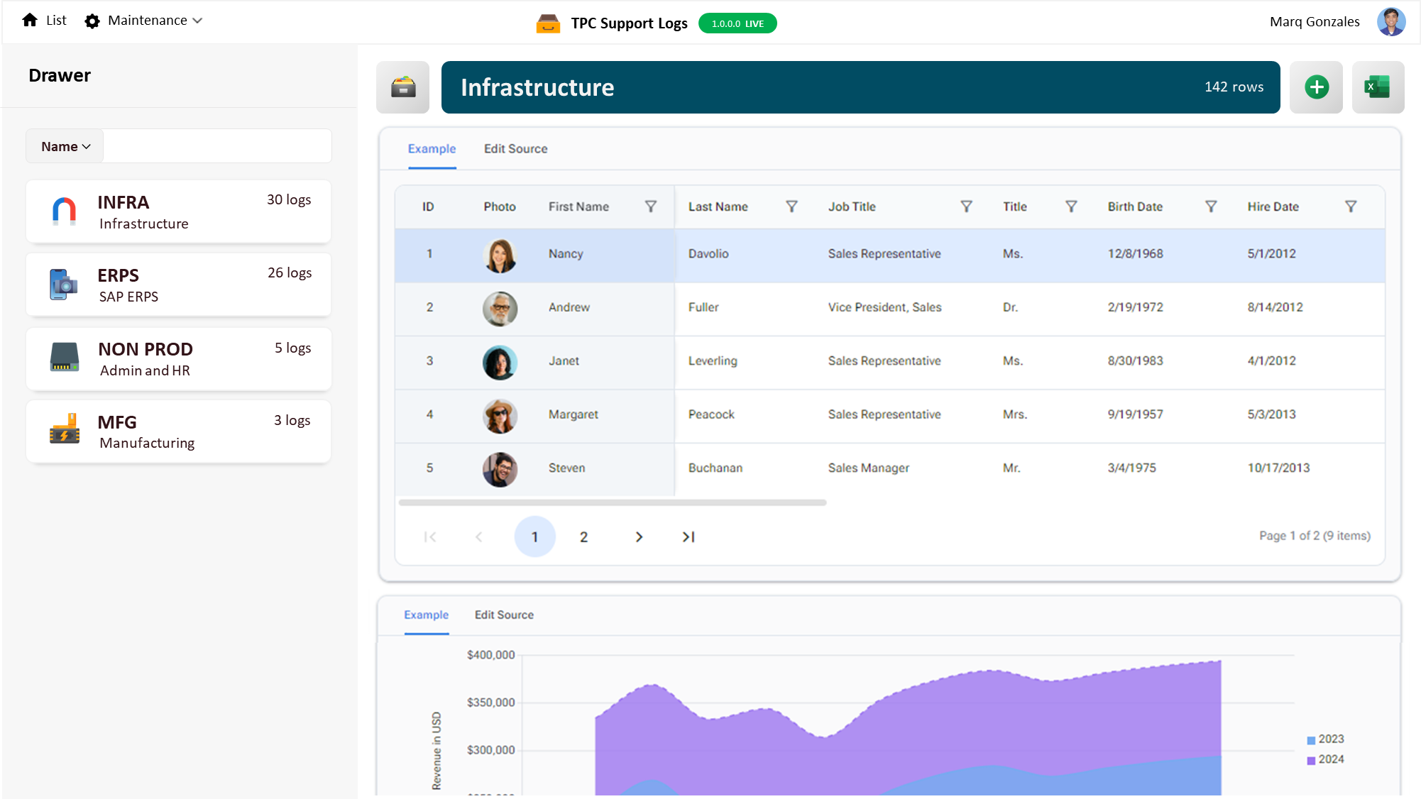




Add Department

Slide 4
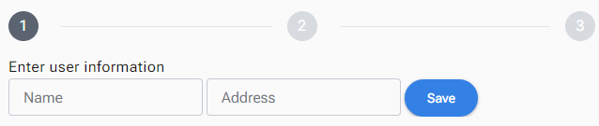



Slide 5
Section
Shift
Support
User
Section ID
Shift ID
Section
Category
User ID
Name
Name
Start Datetime
Details
First Name
Description
Description
End Datetime
Scope
Last Name
Biz Area
Department
Leadtime
Cause
Password
Biz Area ID
Department ID
Shift
Action Taken
PIN
Name
Biz Area ID
Department
Attended By User ID
Email Address
Description
Name
Description
Department Scope
Scope ID
Scope
Category
Department ID
Scope ID
Category ID
Name
Name
Name
Description
Description
Description

